Slide 1

DC-DC Converter for PV Module Integration
Group 760

Slide 2

CONTENT
INTRODUCTION
CONVERTER DESIGN
MPPT ALGORITHM
TESTS RESULTS
DISCUSSION
CONCLUSION

Slide 3
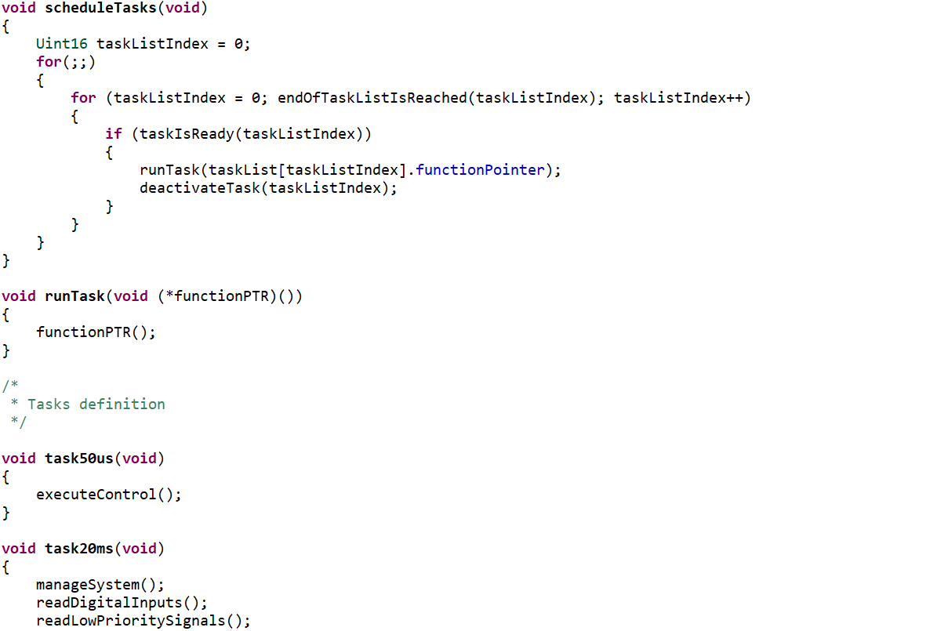
Firmware
Notes:
Motivation
Existing problems
What is a MIC
Why a MIC
Problem statement

Slide 4
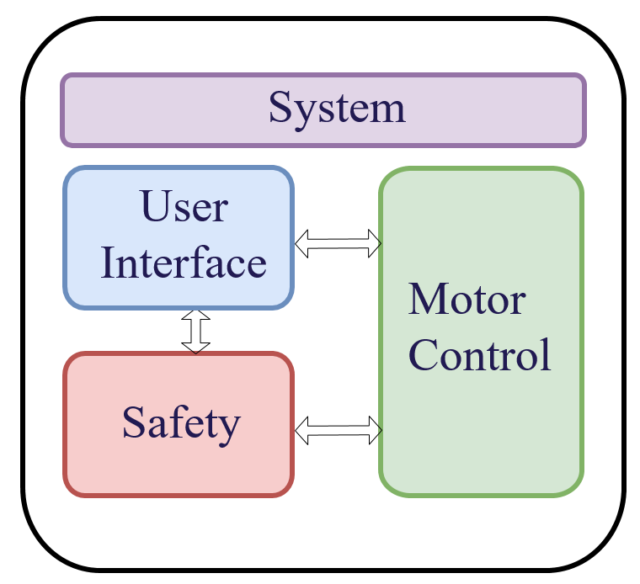
Firmware Design
Slide
of 59
System feature definition
Modular design
Allows collaboration between several developers
Increases scalability
Increases reliability
Allows code reusability
High level design
Low level design

Slide 5
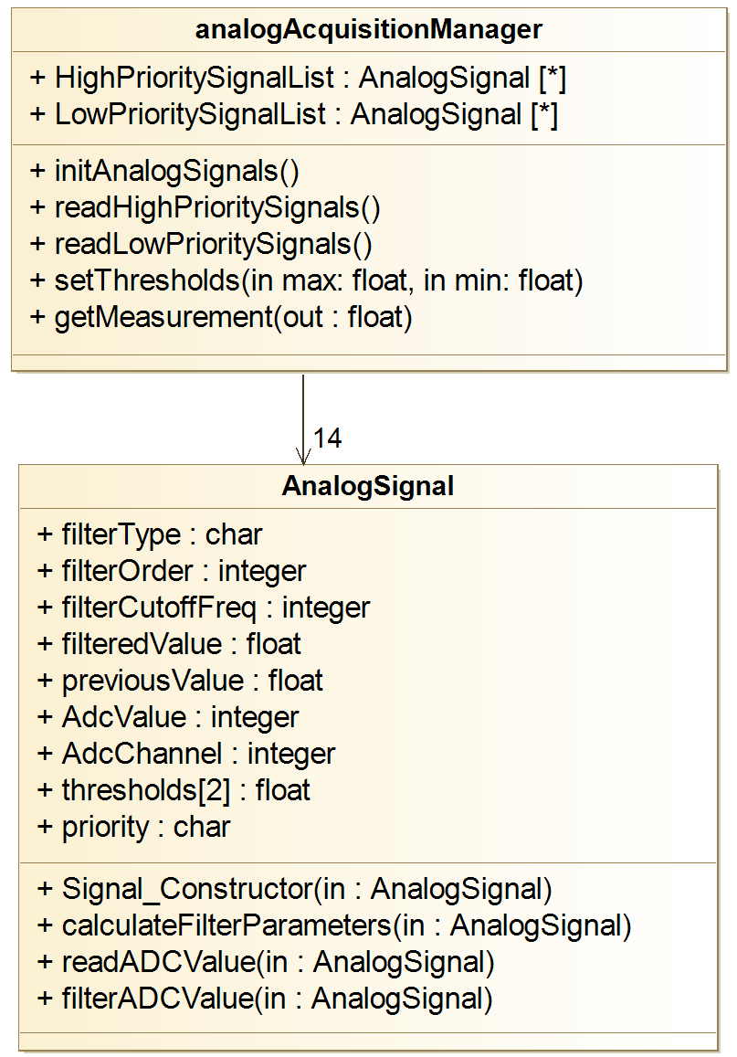
High level design
Slide
of 59
For every software module
What is its goal?
When should the task be performed?
How will it interact with other modules?
Goal
Understand the big picture of the system

Slide 6
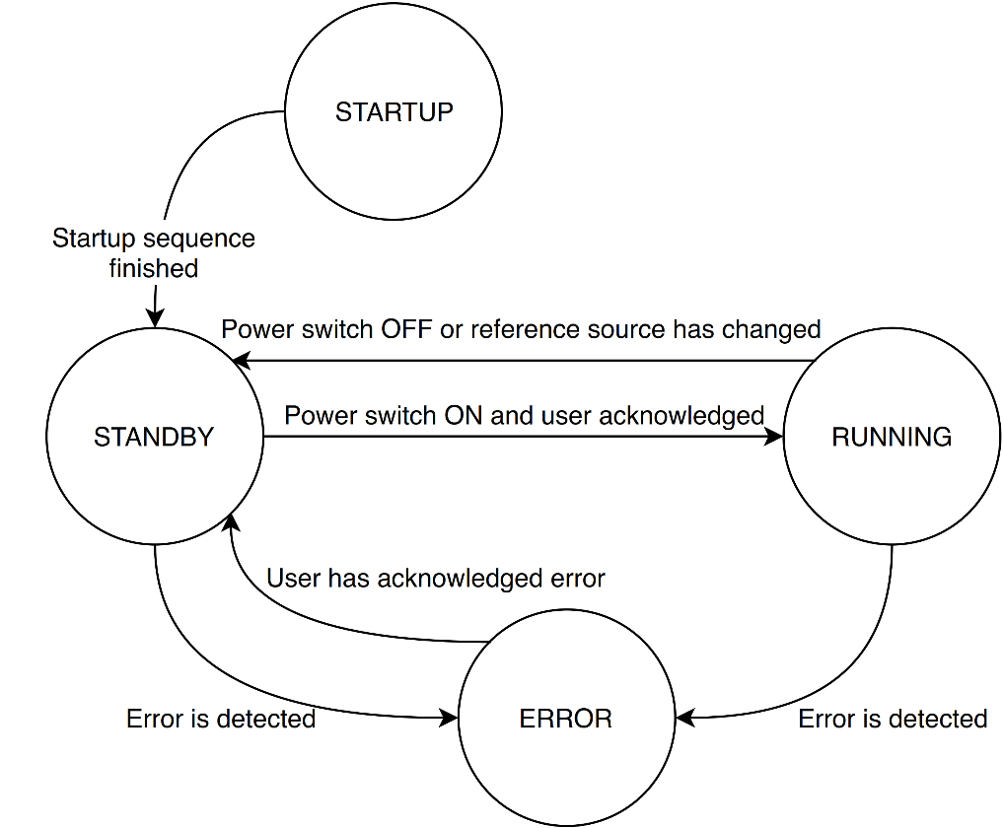
Low level design
Slide
of 59
For every software module
Detailed explanation of how is the task performed, including suggested data types, algorithms or techniques
Goal
Find technical limitations of the system, speed up the development phase

Slide 7
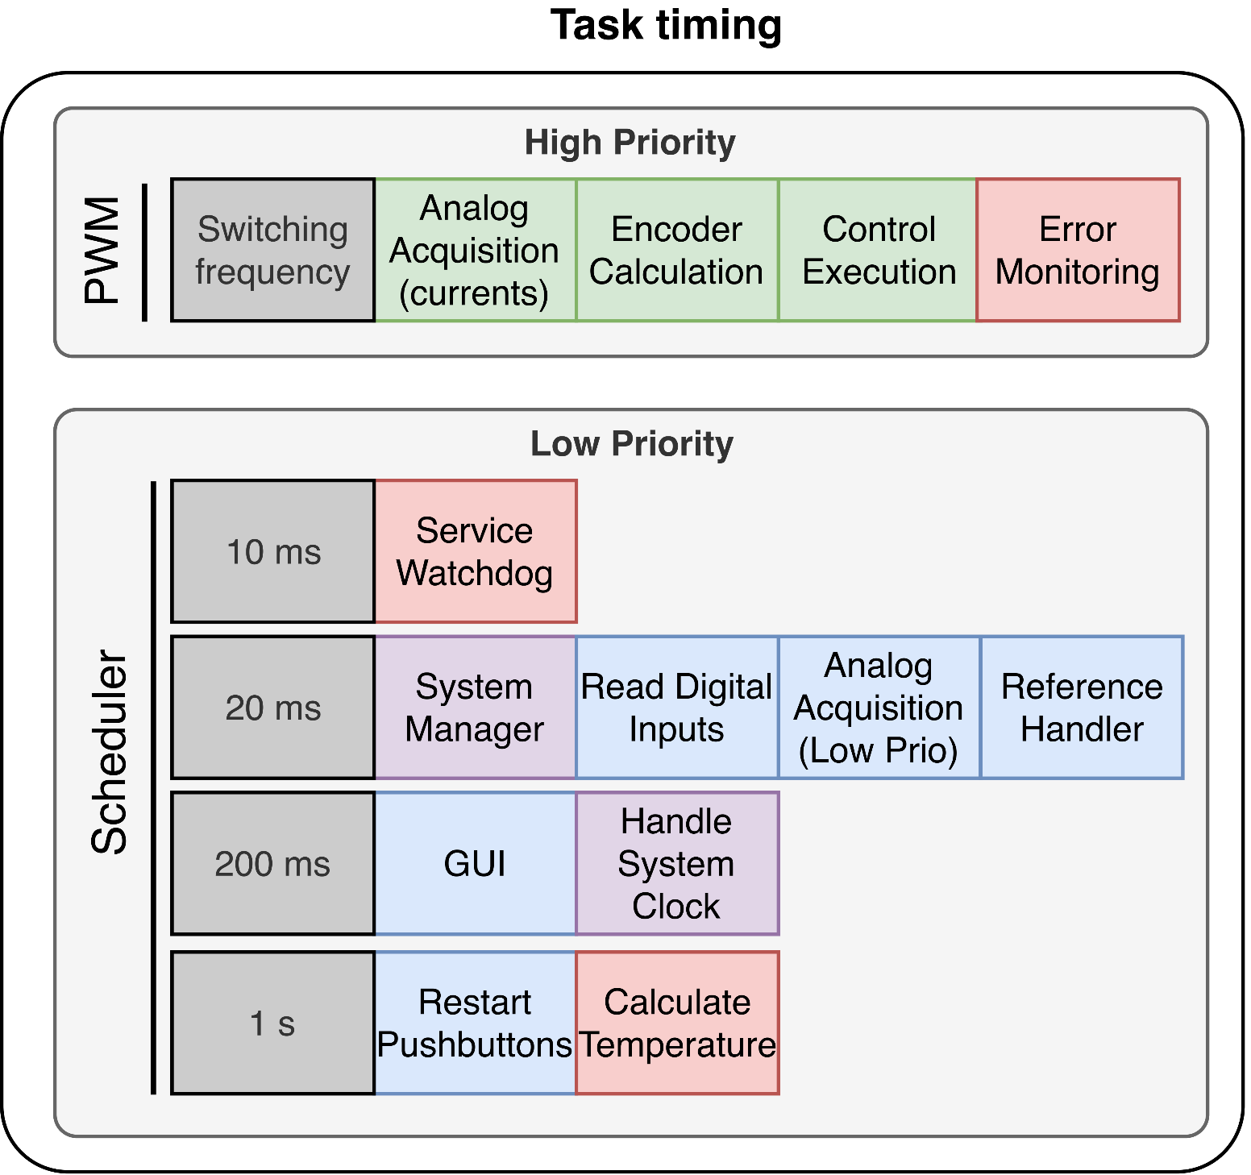
Timing
Slide
of 59
Real time system: Time constraints
Motor control: calculation of new duty cycle every switching period
Other modules → Scheduler

Slide 8
System
Slide
of 59
System are those modules which provide a framework for other modules
System Manager System supervision
Scheduler Task timing framework
Logger Debugging framework

Slide 9
System manager
Slide
of 59
Features
System status
User interaction

Slide 10
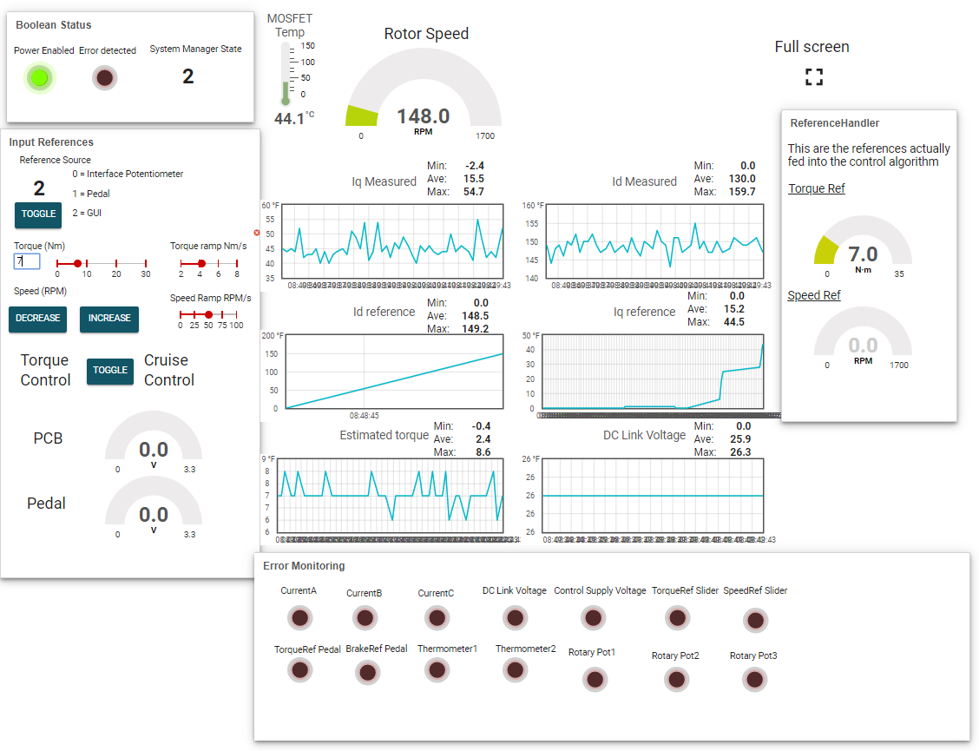
User interface
Slide
of 59
Different sources
Interface PCB
Graphical User Interface
Pedal
Reference Handler

